Slide 1
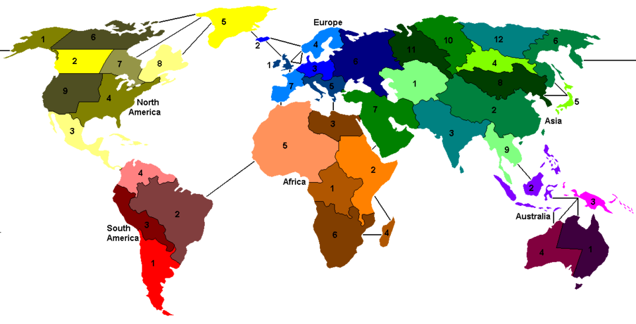
Risk-RL: An approach to the game of Risk through the lens of Multi-Agent
Reinforcement Learning
Michele Scomina - IN2000214 - Reinforcement Learning (453SM)

Slide 2
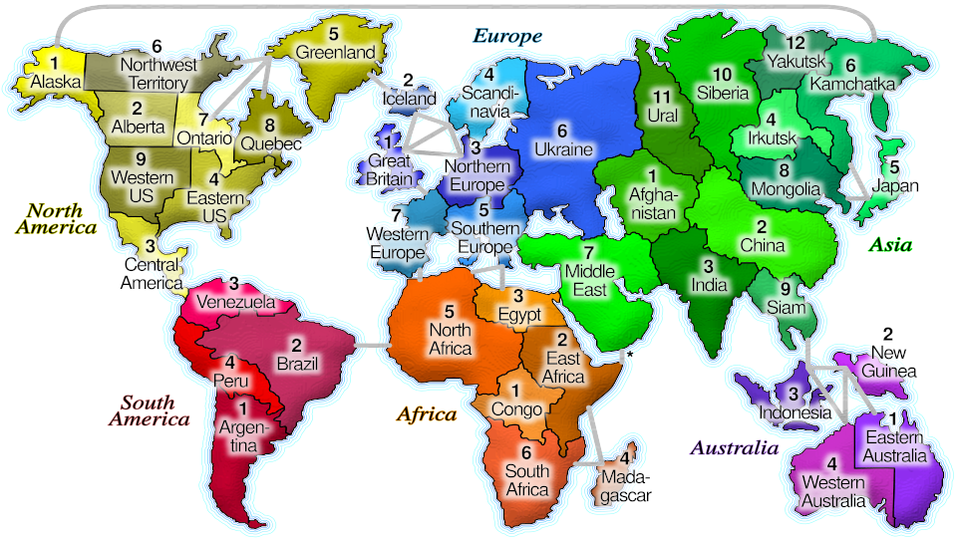
What is Risk?
Game about conquest
Standard map defined by 42 territories and 6 continents
Objective: World domination (own all territories)
2-6 players
Attack outcomes are defined by dice
Reinforcements based on territories
and continents
Cards drawn on conquest, that can be
traded for more reinforcements

Slide 3
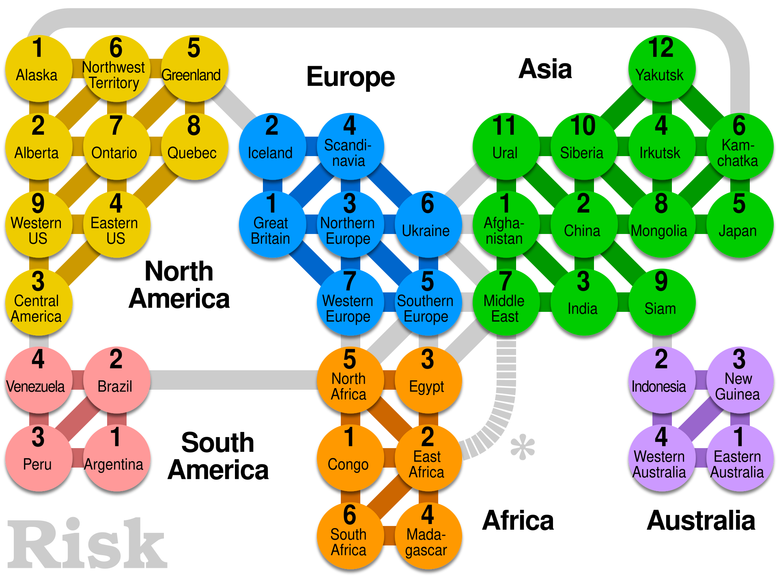
Environment description
The Risk map:
Can be seen as a connected graph
Territories can be treated as nodes
Connections can be treated as edges
Graph theory and notation can be used in the definition of the state.

Slide 4
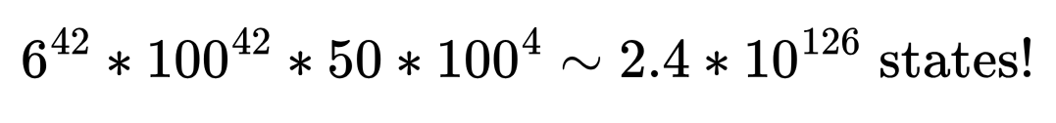
Environment description
42 territories, owned by 2-6 players.
Arbitrary amount of armies on each territory.
Troops to place, can be an arbitrary number.
Arbitrary amount of cards in hand.
Even with a low estimate, function approximation is pretty much mandatory.

Slide 5
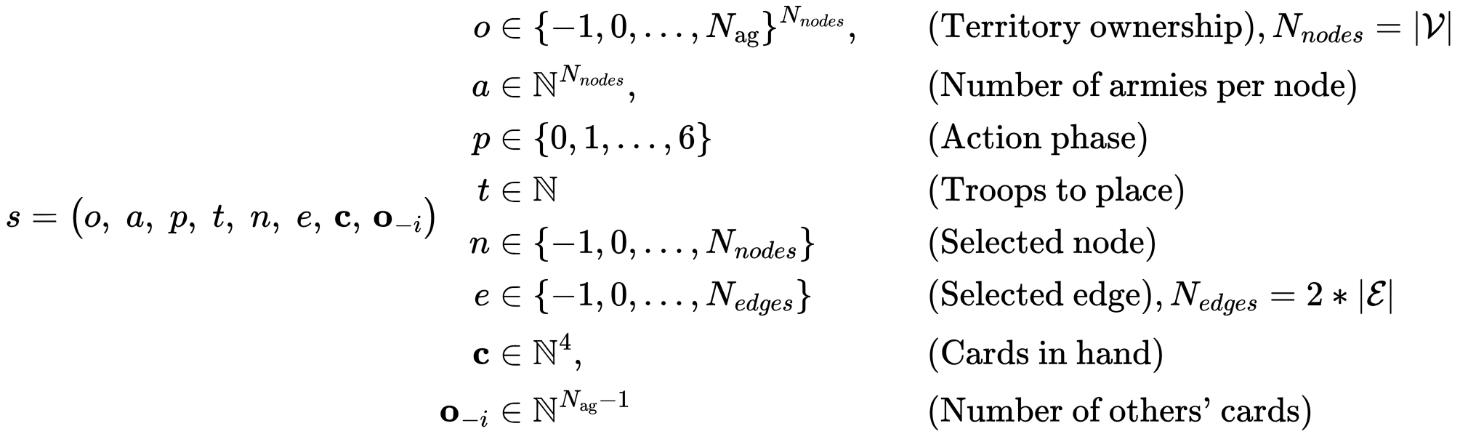
Observation definition

Slide 6

Action space definition
The action space requires more careful considerations:
Combination of armies to place/move/attack with and selection of node/edge can make the size of the action space explode
The naive approach: combine them all in one big action
Potentially massive size!

Slide 7
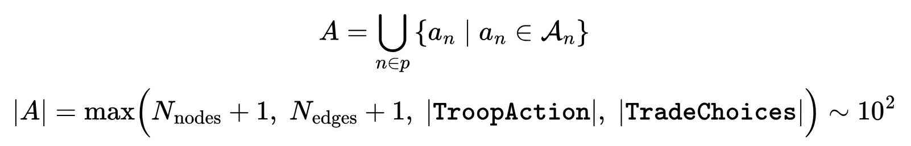
Action space definition
Instead:
Observation space contains extra values (phase, selected node/edge)
Action space is actually a sub-action and its meaning depends on the observation state.
We limit the choice of armies to set percentages, instead of an arbitrary amount.

Slide 8
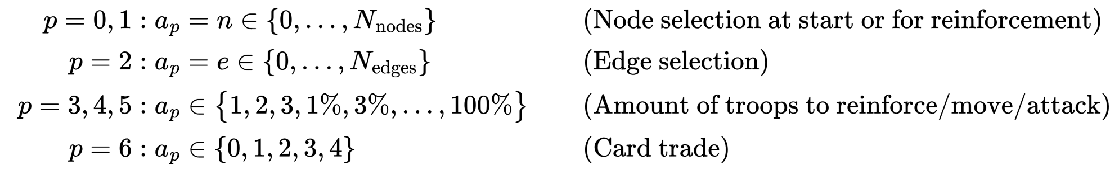
Action space definition

Slide 9
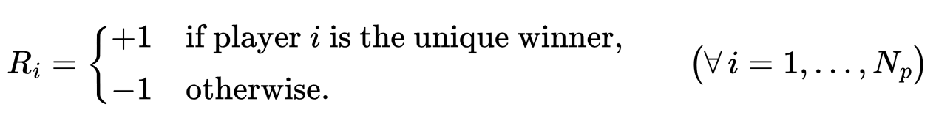
Reward definition
Generally:
Reward of 1 for winning and -1 for losing is often good enough.
The problem: Risk is a game that can last hundreds or even thousands of turns.
Rewards are too sparse!

Slide 10
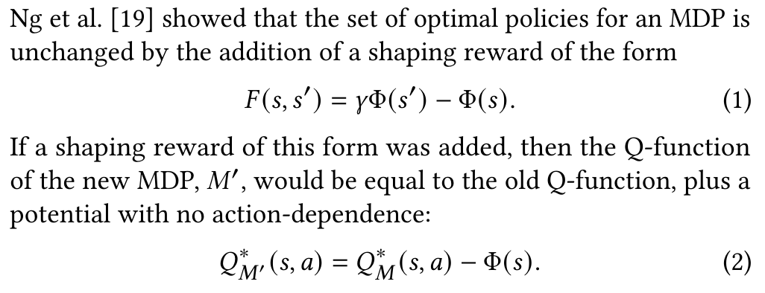
Potential-based reward shaping (PBRS)
Source: “Potential-Based Reward Shaping For Intrinsic Motivation” by Grant C. Forbes et. all, 12 Feb 2024

Slide 11
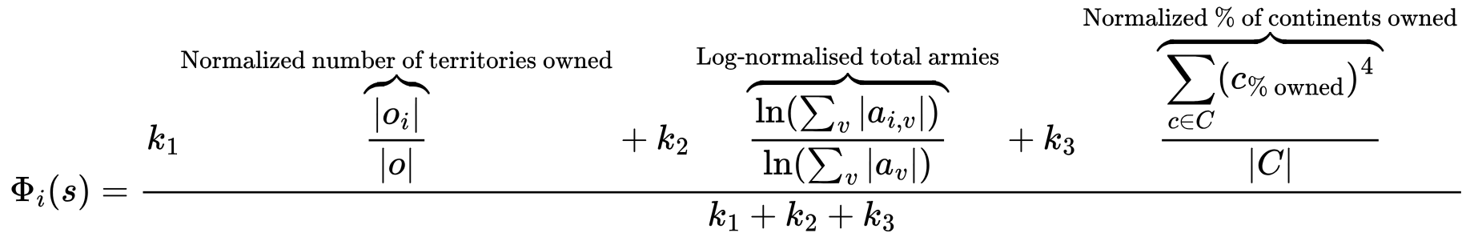
Potential-based reward shaping (PBRS)
By adding PBRS, agents will have an easier time learning the optimal policy:
This is a heuristic assumption of each player’s approximate level of strength.
It incentivizes players to increase their level of strength over time.

Slide 12
Summary
Risk:
Is partial information (no knowledge of cards in hand)
Has stochasticity (outcome of battles)
Has a very large state space
What is the best algorithm to use?

Slide 13
Proximal Policy Optimization (PPO)
On-policy, Actor-Critic policy gradient algorithm
Intrinsic definition of exploration through entropy in actor loss
Very efficient optimization of large neural networks
Relatively small amount of hyperparameters
Works with (almost) any kind of observation and action space

Slide 14
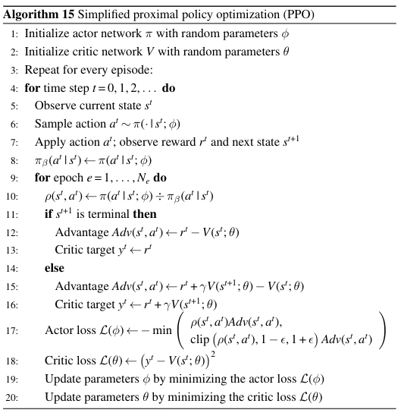
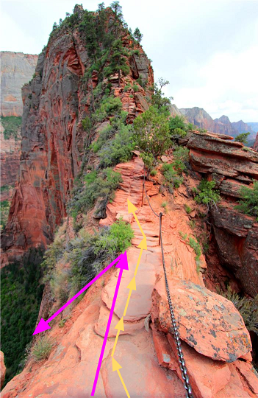
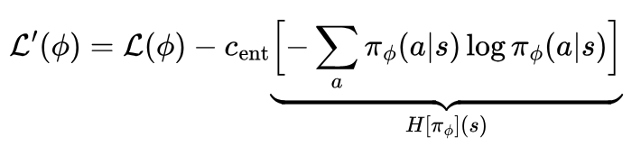
Proximal Policy Optimization (PPO)
Source: “Multi-Agent Reinforcement Learning: Foundations and Modern Approaches” by S. V. Albrecht et. all.

Slide 15
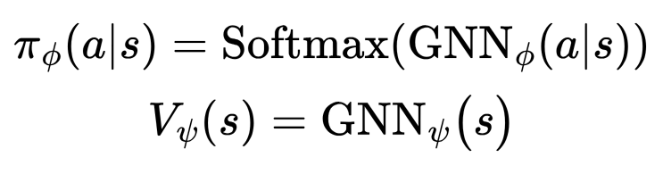
Actor/Critic model
We need to define a model for the actor and critic alike.
Risk (and its state representation) is completely definable through a graph.
Idea:
Use a Graph Neural Network as a model for estimating the logits for each single node and edge. It can also be repurposed as a Q-Value estimator.

Slide 16
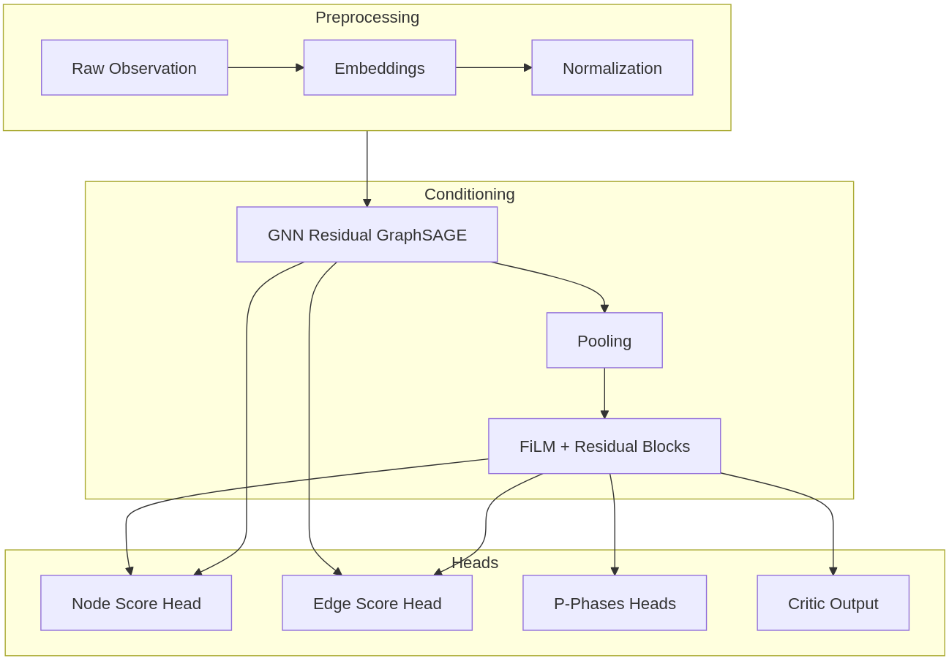
Actor/Critic model

Slide 17
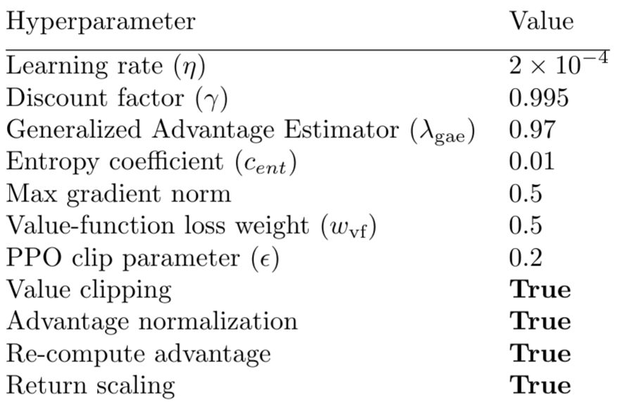
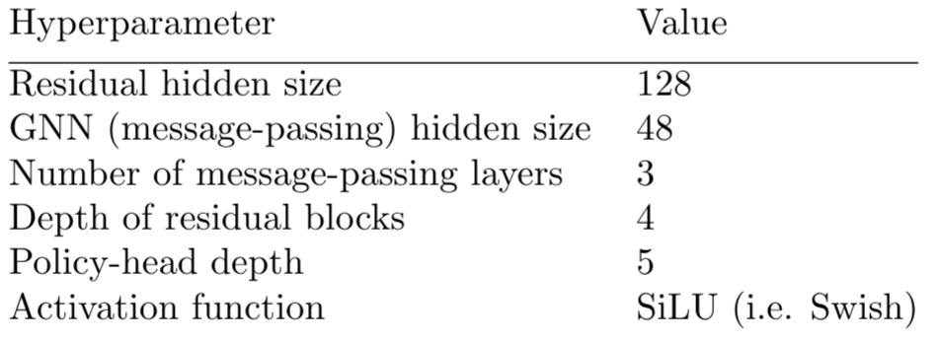
Hyperparameters
PPO
GNN

Slide 18
Training information
~150 epochs of training
~100 million environment steps
~6 hours of IRL train time
The agent starts to play against random bots, then steps up to self-play

Slide 19
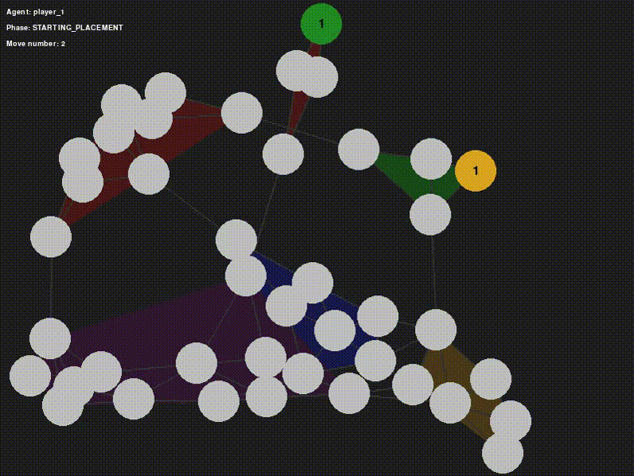
Example games

Slide 20
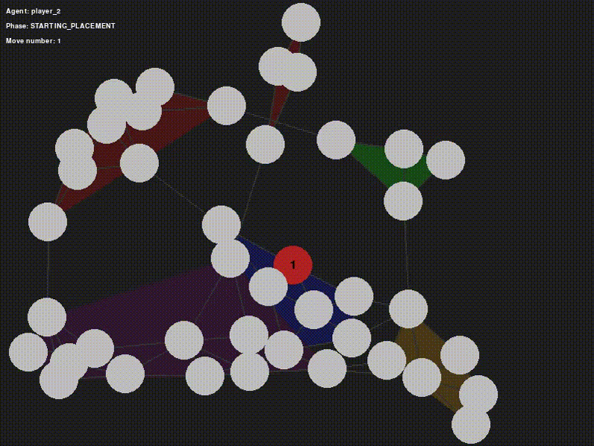
Example games

Slide 21
Strategies exhibited
Potential for improvement
Aiming for continent ownership at the beginning
Aiming for isolated areas (Australia, South America)
First strike advantage is good, opponents will have less reinforcements
Interfering with others’ continent ownership is good
Stacking troops near potential conquest zones
Adding stronger communication between players (big players currently snowball into winning)
Improving normalization strategies for better map generalization

Slide 22
Conclusions
We showed the PPO/GNN framework:
Scales very well to large state spaces
Develops effective strategies, similar to what expert players use
Easily extensible with further features

Slide 23
Thank you for your attention!

